Slide 1

Interactive Narrative Yi-Chun (Rimi) Chen Part of Slides: Dr. Arnav Jhala & Dr. Chris Martens

Slide 2
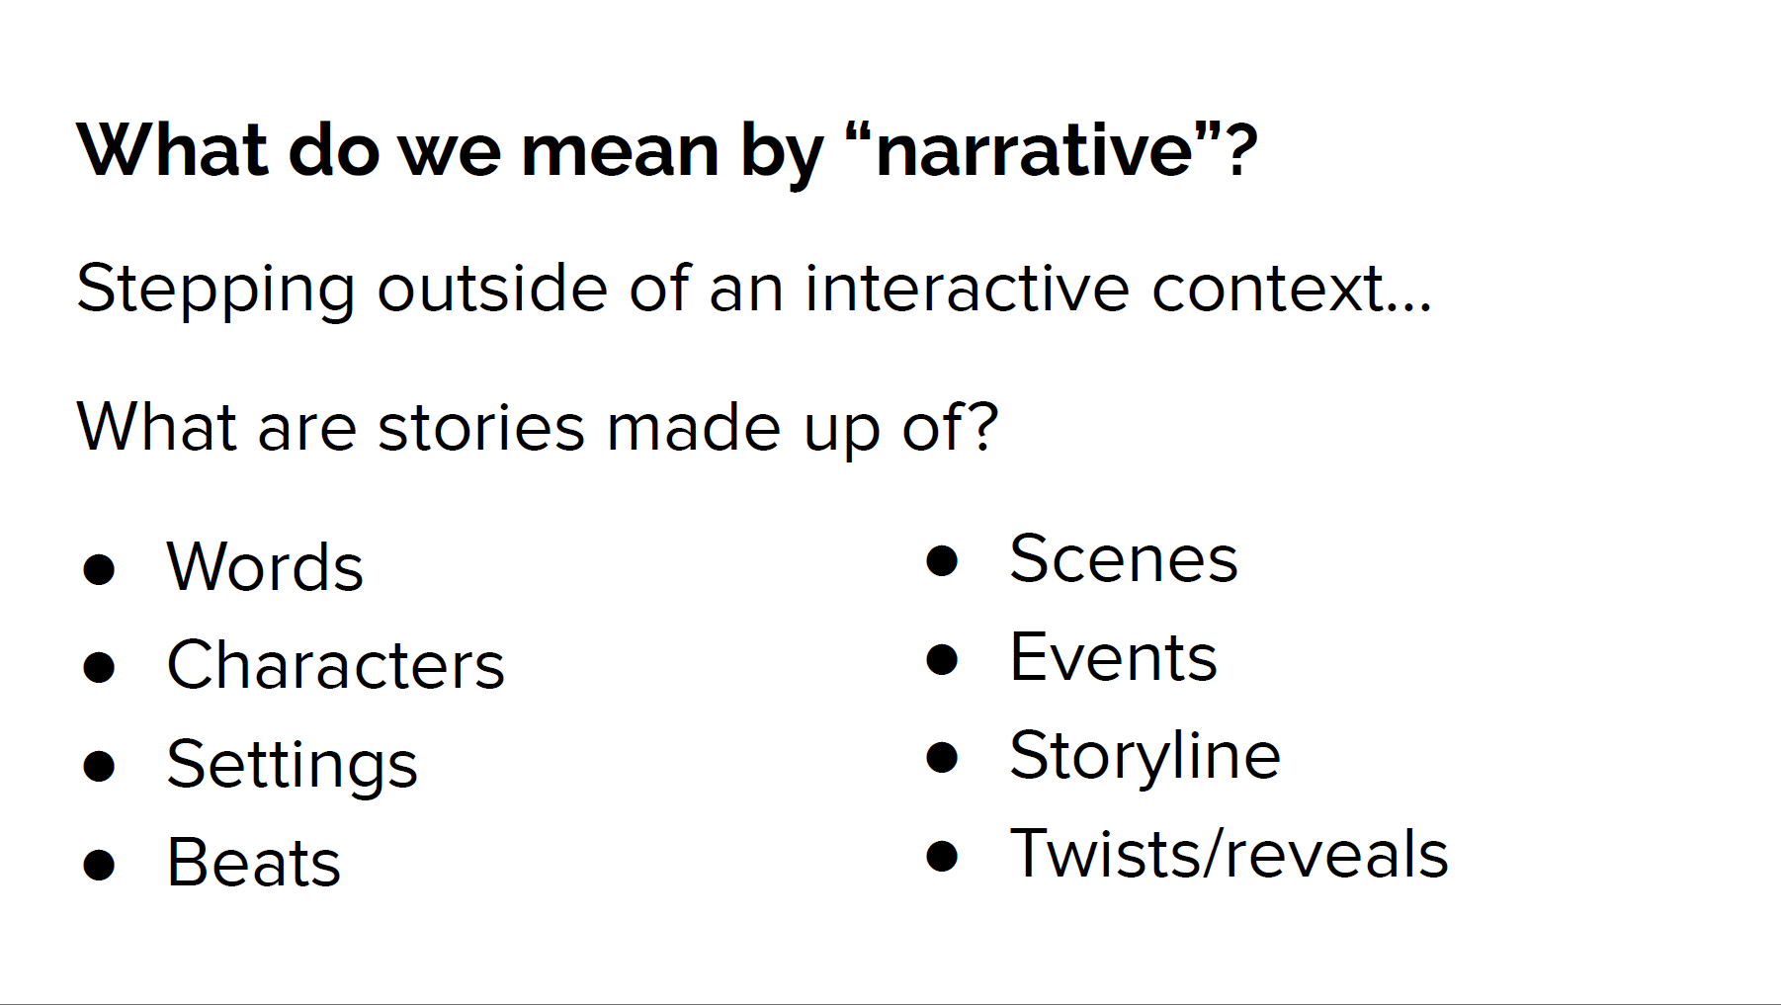

Slide 3
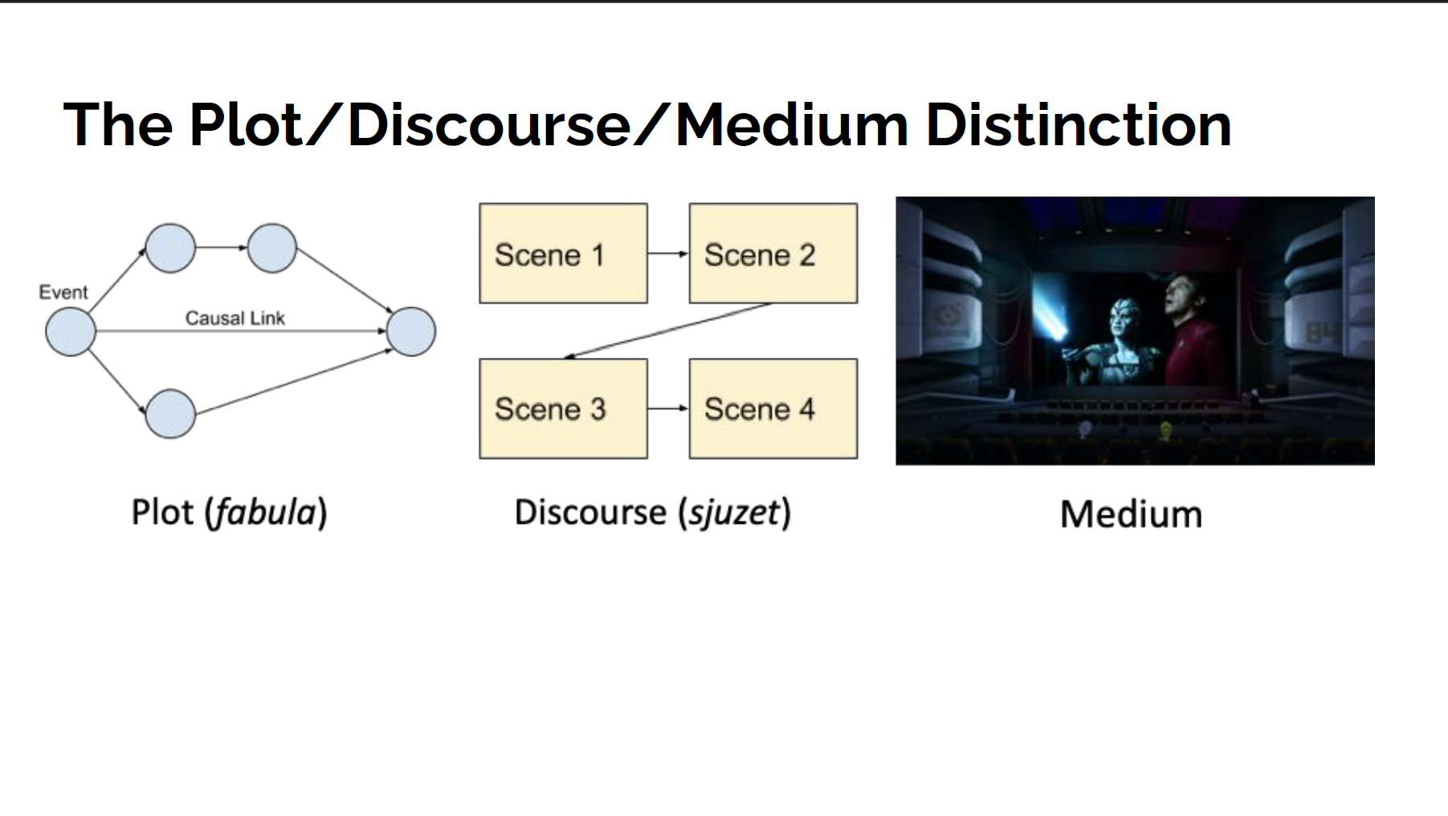

Slide 4
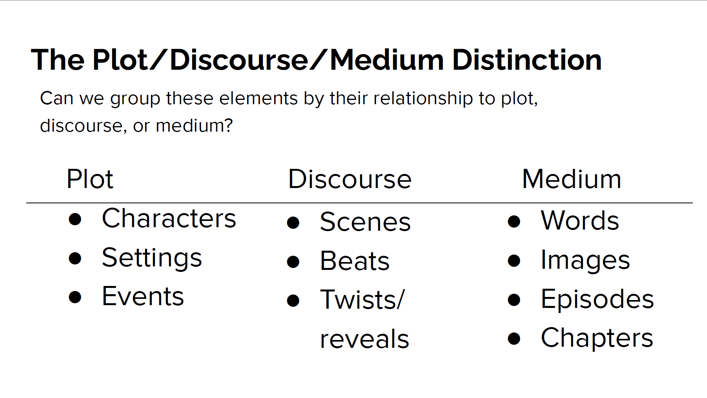

Slide 5


visual narrative, AI, and human creativity
Multimodal Processing
Knowledge representation
Comprehension
Semantics
Visual Representations
Storytelling
Generation
Visual Narrative
Interactions
Temporal Dynamics
Comprehension
Emotions
Cultural Context
Multimodality
Multimodal Creation
Feedback
Artistic Expression

Slide 6


Content
Models
Content Modeling
Content
Event
Scene graph
Action graph
Cause
Close
Look
Agent
Topic
Transfer info
Read
Notice
During
Recipient
Put
Speak
Image Sequence Model
Sample System: Action Causal Network

Slide 7


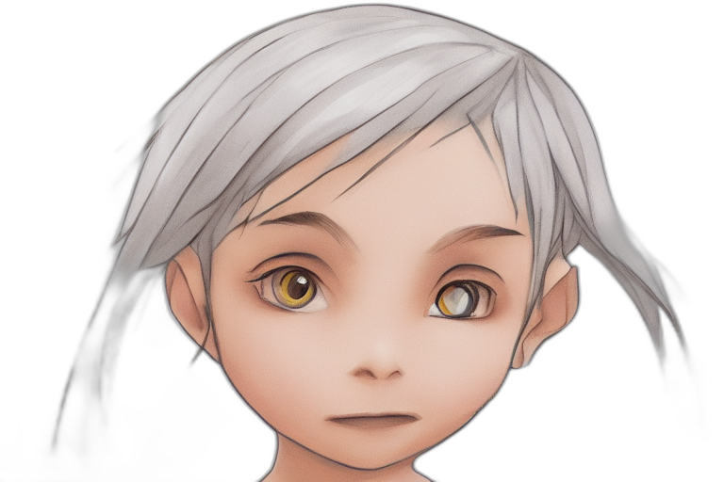

Rendering : Visual-Layer
GUI
Visual Sets & Data
Models
Renderer
Back
Composition
Layer-wise rendering
Inspired by game scenes and art expressions
Simplified and specialized the function of each layer
Flexibility to Apply as many layers as customized visual representation sets
Redraw the selected part by altering the image or generative model → to remove the background for sprites.
Front
Effects

Slide 8
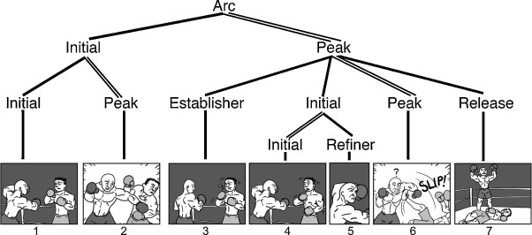
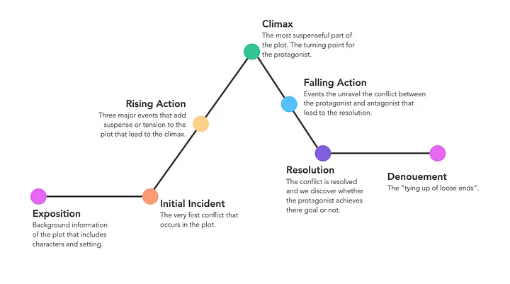
Discourse: Narrative Structure and Grammar
Generator
Image Sequence Model
Grammar
Narrative
Narrative Arc (Gustav Freytag)
Narrative Grammar (Neil Cohn)
chronological construction of a plot in a story
Phase: (Establisher) - Initial(Prolongation) - Peak - (Release)

Slide 9
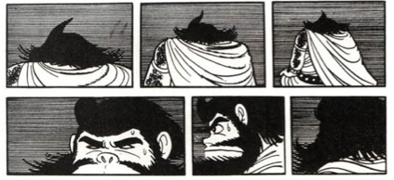
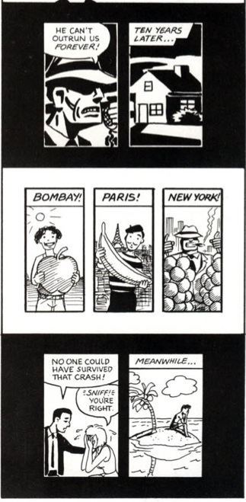
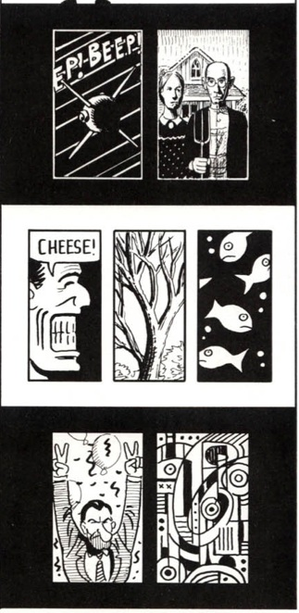
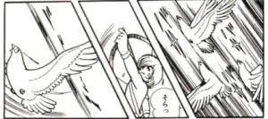
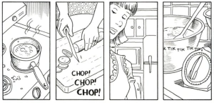
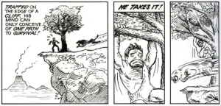
Narrative Transitions
Scene
Non-sequitur
How planned content be discoursed (McCloud’s theories)
Moment
Object
Aspect
Action
Scene
Non-sequitur
Moment
Object
Aspect
Action
[Images: https://understandingcomics177.wordpress.com/about/1-2/2-2/]
[Understanding Comics: The Invisible Art, McCloud, 1993]

Slide 10

(Establisher) - Initial(Prolongation) - Peak - (Release)

Slide 11
Narrative System Design Choice
Purpose of Narrative
Inform / Explain Facts
Engage / Teach / Reflect
Need user choices? No
Or single storyline
Need user choices? Yes
Or adaptive outcome
Visual Narrative (Static)
Visual Narrative (Dynamic)

Slide 12


Slide 13
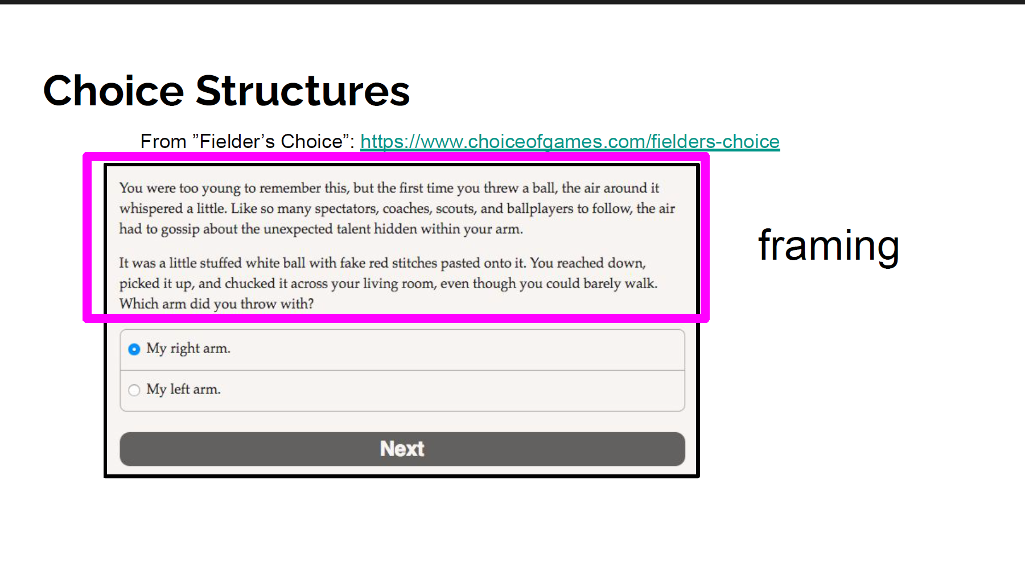

Slide 14
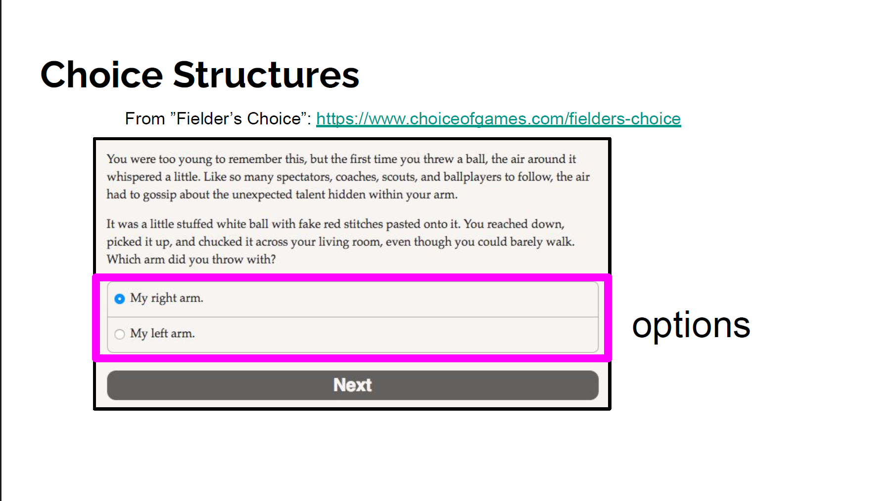

Slide 15
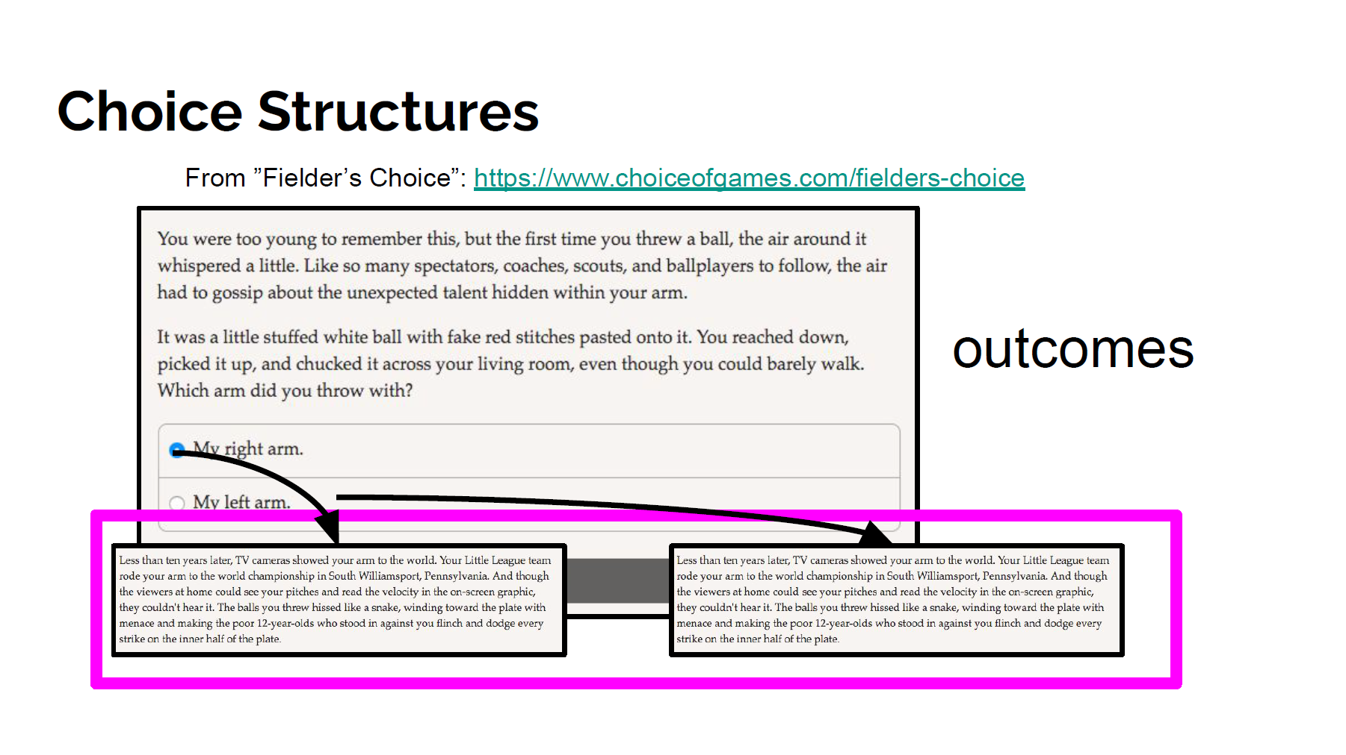

Slide 16
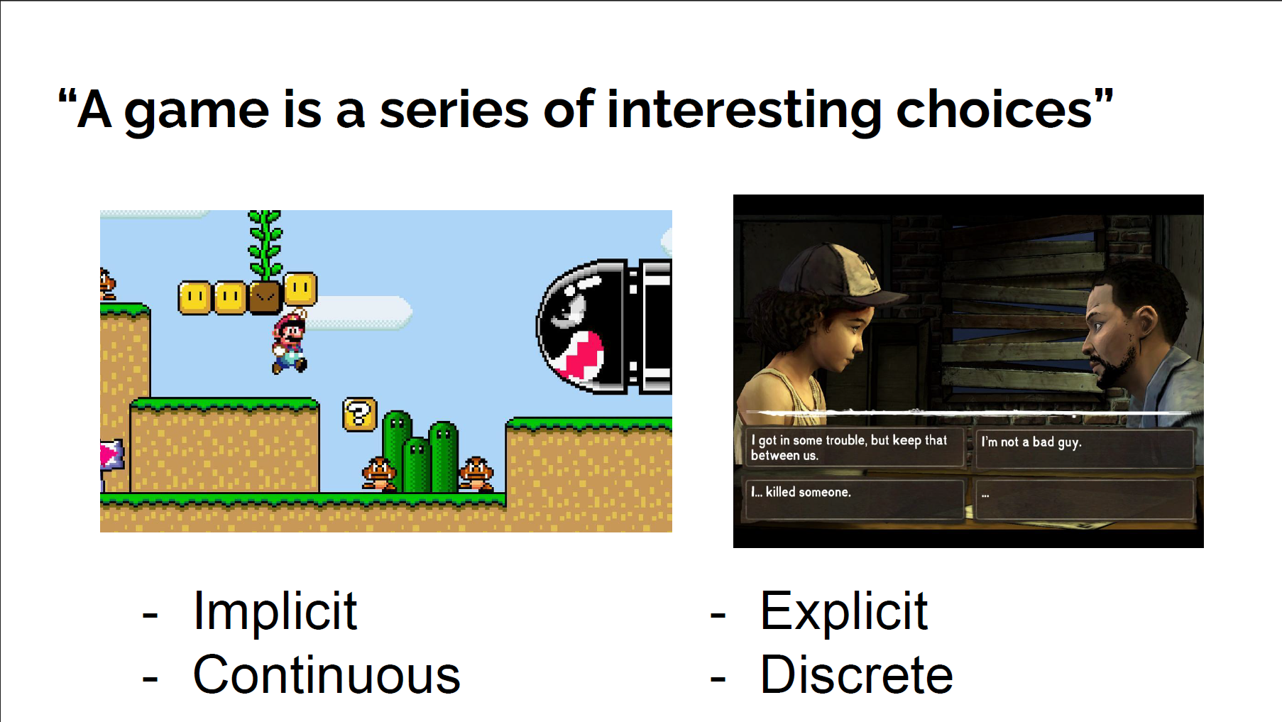

Slide 17
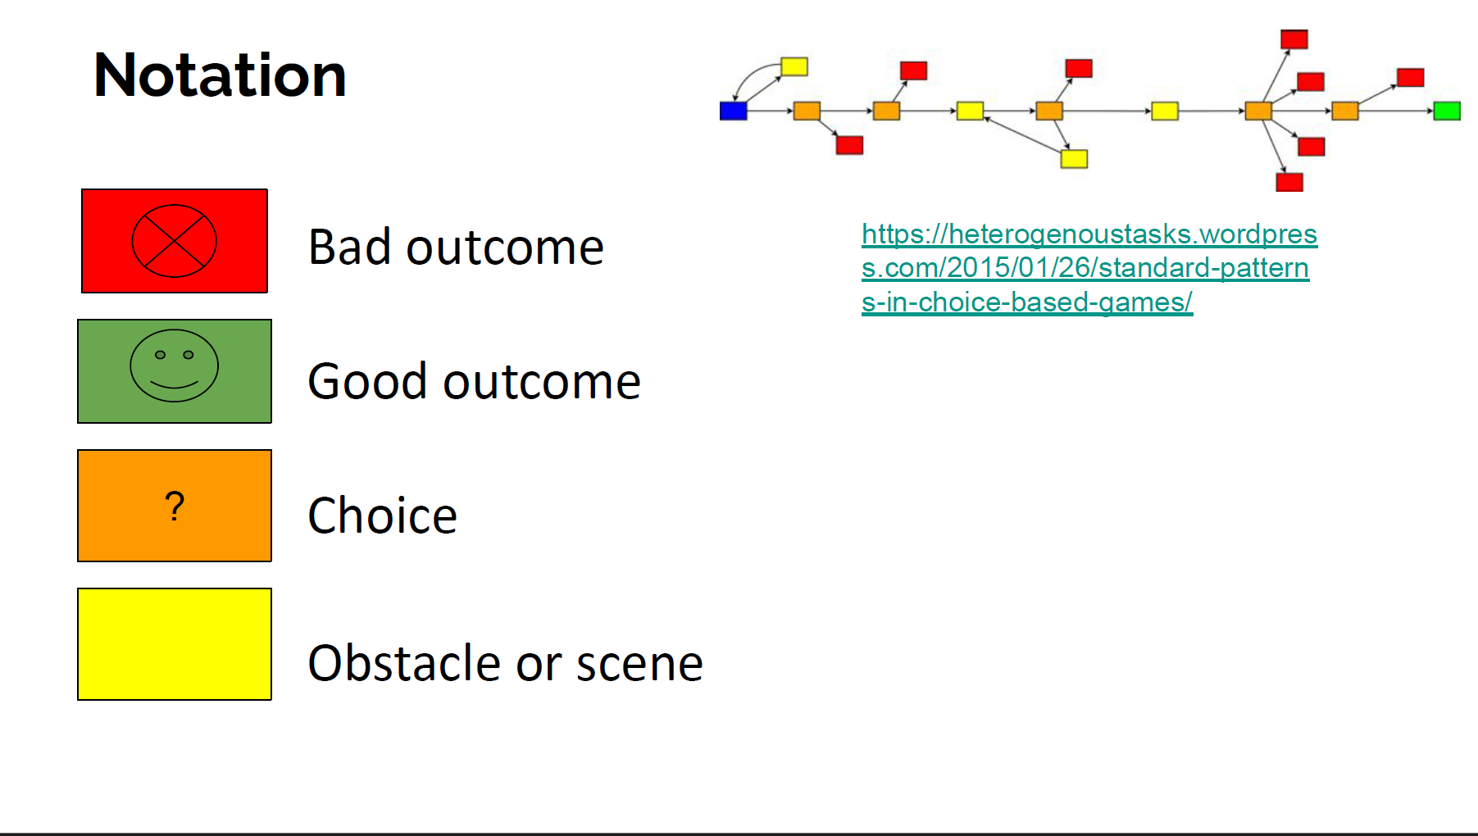

Slide 18
Visual Narrative as a Human-Centered Design Process
Designing a visual narrative is not just about visuals — it’s about understanding who the story is for, why it’s told, and how it should be experienced.

Slide 19
Visual Narrative as a Human-Centered Design Process
Category | Key Questions to Ask
Purpose | • What is the goal of the narrative — to inform, educate, persuade, or empathize? • Is it meant to convey facts, evoke emotion, or guide decision-making?
Audience | • Who are the intended viewers or participants? • What prior knowledge, emotion, or context do they bring?
Engagement | • Should the user be a passive viewer or an active participant? • Are choices, feedback, or interaction needed?
Medium & Context | • Where and how will it be experienced (poster, animation, app, interactive web, etc.)? • What are the platform’s constraints and affordances?
Narrative Structure | • Is the story linear, branching, or adaptive? • Does it focus on a single perspective or multiple viewpoints?
Emotional & Ethical Considerations | • How do we ensure empathy, accessibility, and respect for the subject matter? • Are there sensitive topics or user emotions to consider?

Slide 20
Thank you

